Slide 1
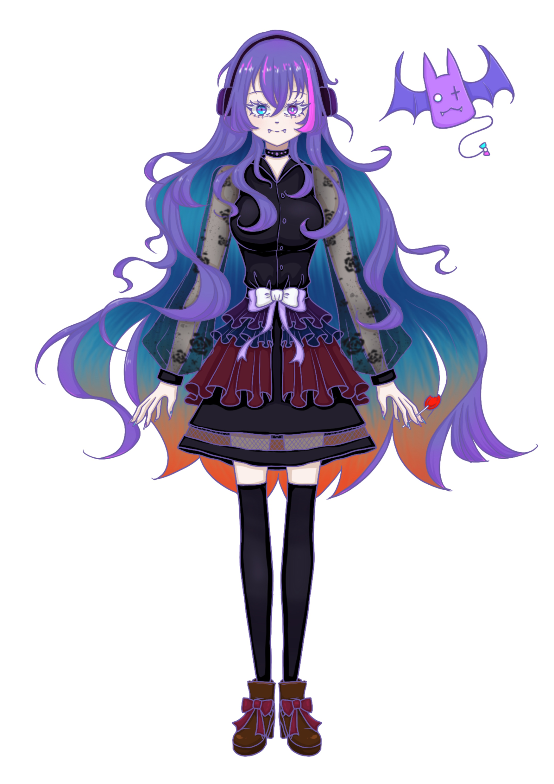

Slide 2

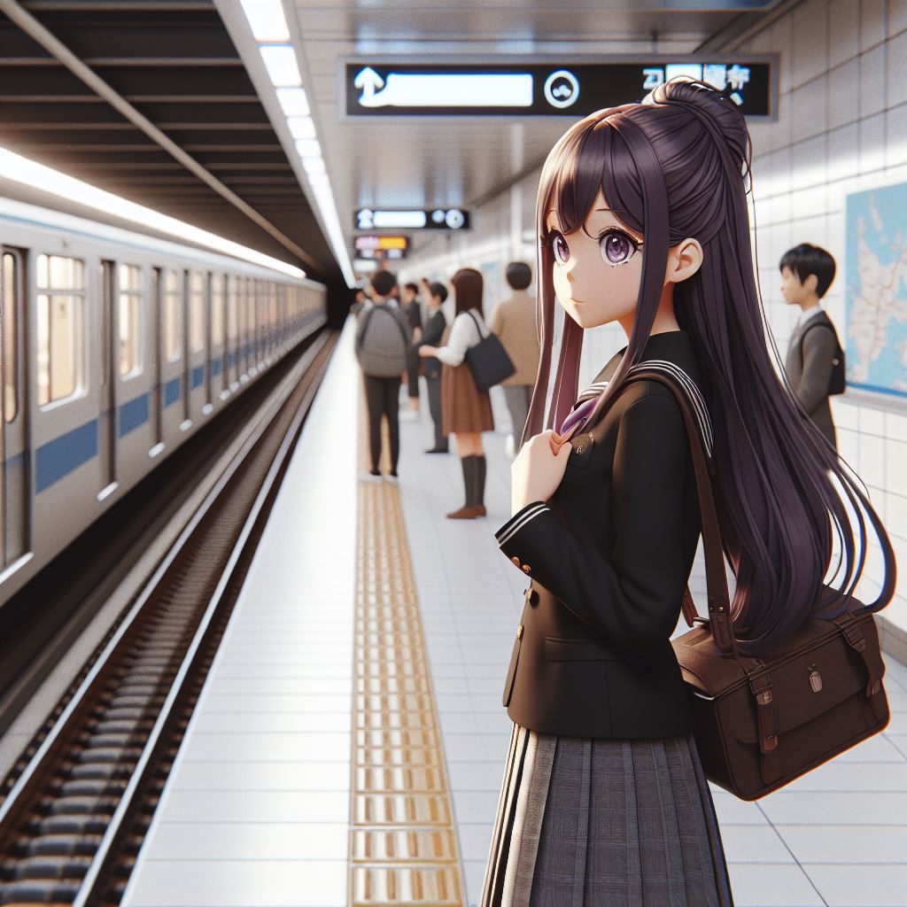
Notes:
An animated girl with long purple hair, dressed in a black high school uniform, going to take the subway to school

Slide 3

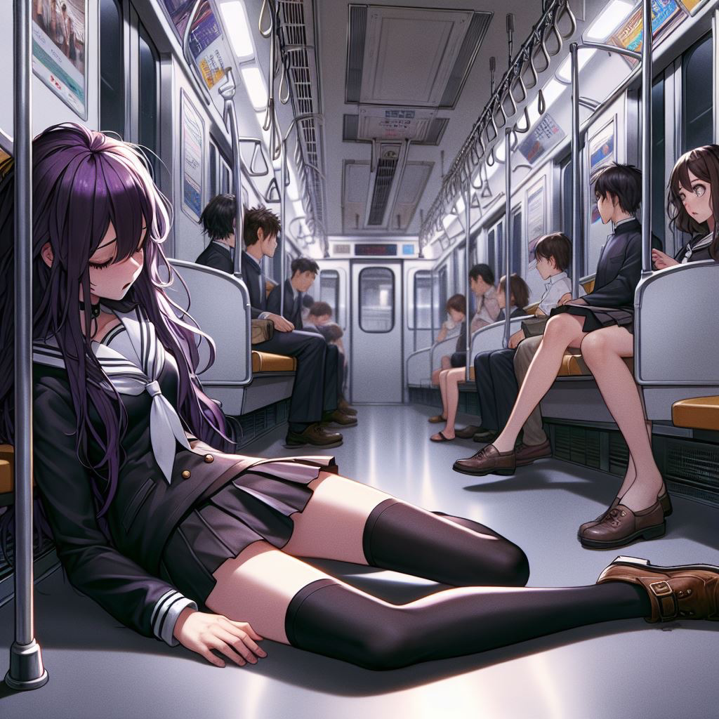
Notes:
An animated girl with long purple hair, fainted in the subway carriage because of lacking oxygen and anemia, in the Japanese anime art style, dressed in a black high school uniform, in the same art style and composition as the previous images

Slide 4

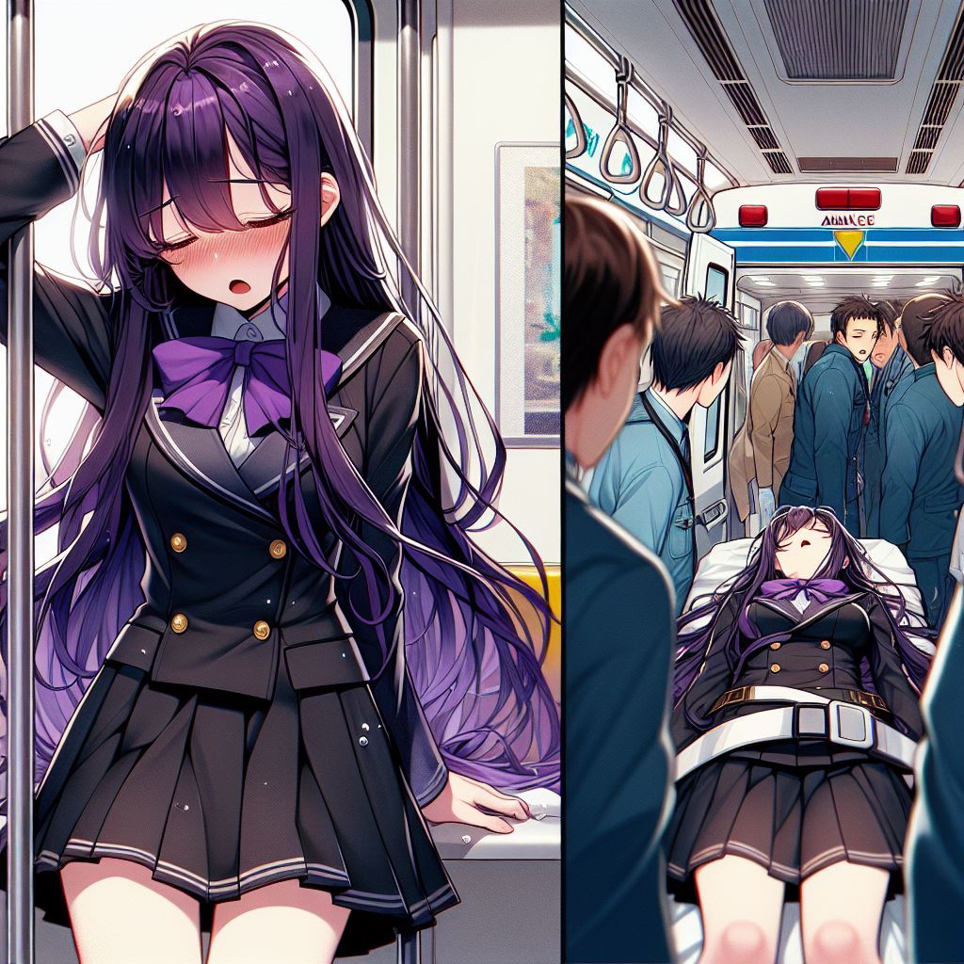
Notes:
long purple hair, fainted in the subway carriage because of lacking oxygen and anemia, in the Japanese anime art style, dressed in a black high school uniform, being helped by the people around her and sent to the hospital, in the ambulance scene, with her eyes closed, in the Japanese anime art style.

Slide 5
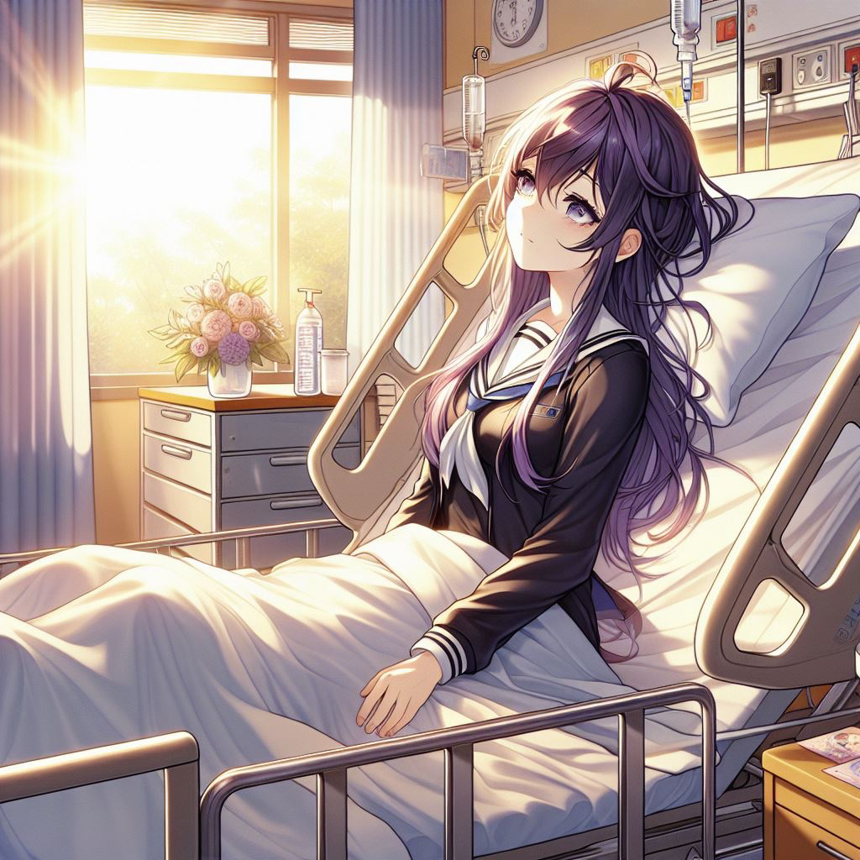

Notes:
An animated girl with long purple hair, waking up in the hospital bed, in the Japanese anime art style, dressed in a black high school uniform

Slide 6
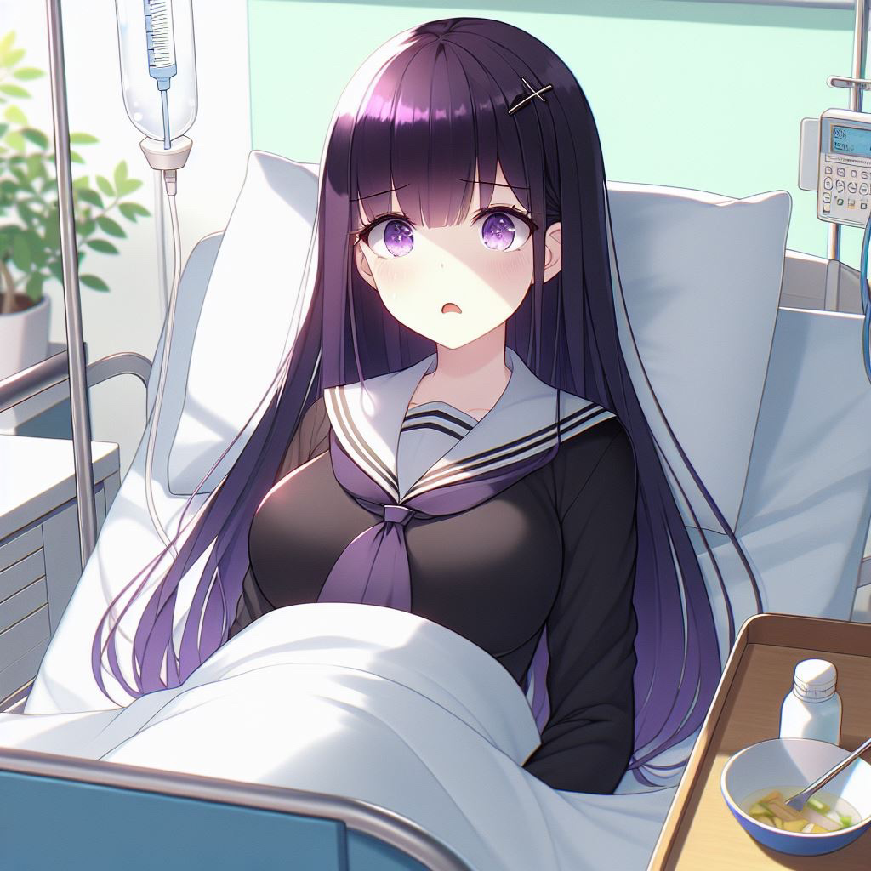

Notes:
An animated girl with long purple hair, waking up in the hospital bed, in the Japanese anime art style, dressed in a black high school uniform, finding out that she couldn't taste any flavor of food

Slide 7
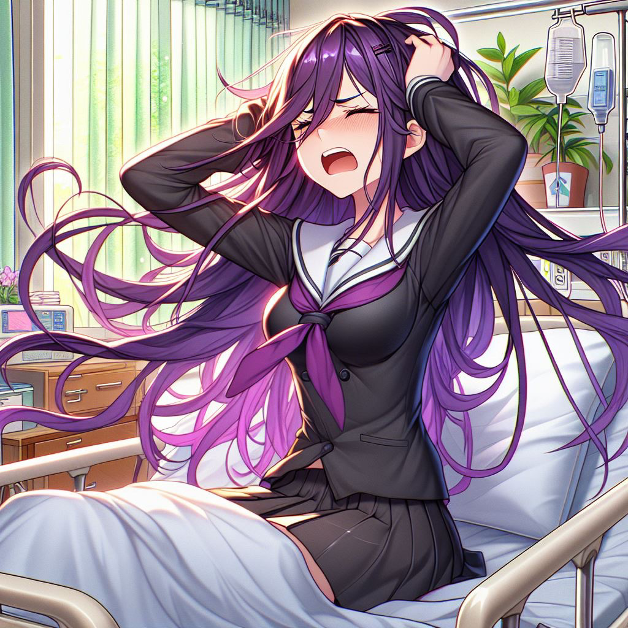

Notes:
long purple hair, waking up in the hospital bed, in the Japanese anime art style, dressed in a black high school uniform, feeling depressed and frustrated, throwing things around her, accidentally getting hurt and bleeding a little bit, showing her expression of frustration and pain.

Slide 8
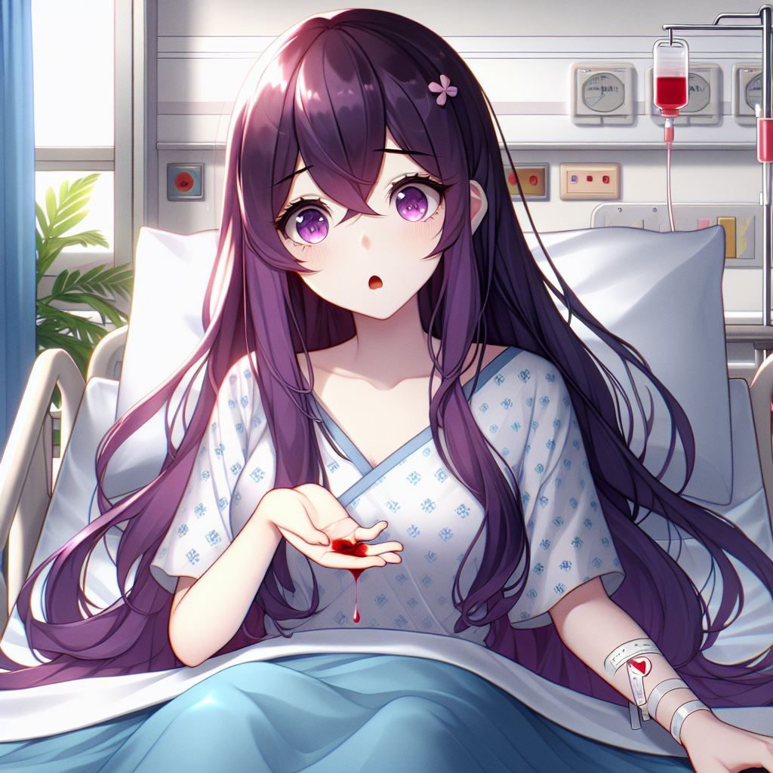

Notes:
An animated girl with long purple hair, waking up in the hospital bed, in the Japanese anime art style, tasting a little drop of a red liquid on her hand and found out it is very sweet and tasteful

